Slide 1
FALSIFICATION & FLAT-TUMMY SHAKES
BQ6 Experts Lesson 7
I can explain how we can draw on the idea of ‘falsification’ to help us manage our scepticism of knowledge claims
Notes:
See how this lesson links to the course by viewing the final slide
Key TOK terms appear in a red font

Slide 2
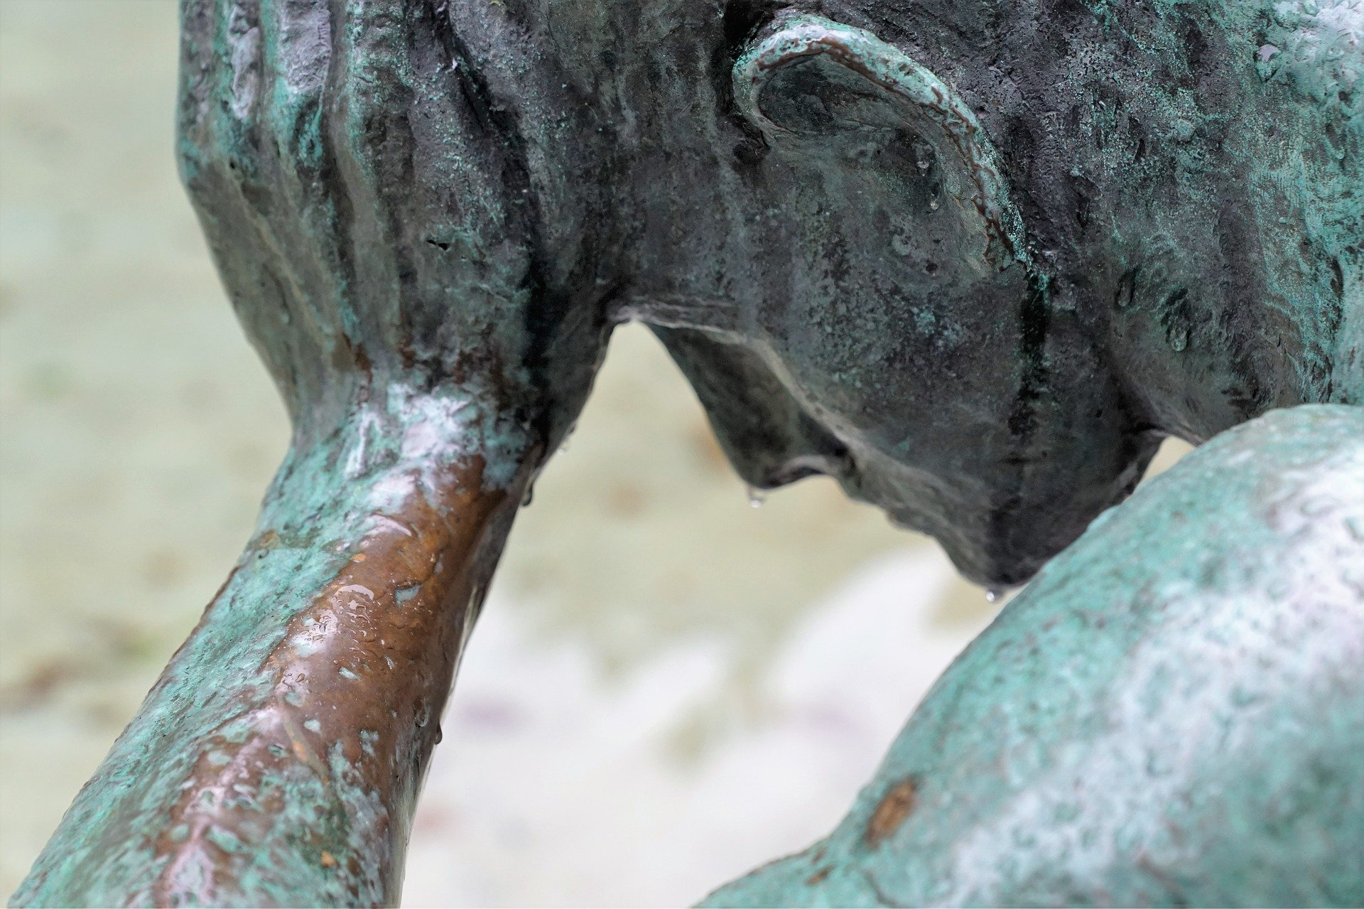
Starter
What does it mean to be ‘sceptical’ of something?

Slide 3
Scepticism, sceptical -
Doubting the truth or usefulness of a statement made about the world
Examples
There was a mood of scepticism at the conference.
Some people are sceptical about the effectiveness of donations made to charities.
Eventually he overcame his scepticism, and decided to give it a try.
Despite the overwhelming scientific consensus, there is scepticism among some people about the theory that climate change is hastened by human activity.
Notes:
Or with a ‘k’ if you’re American…
Read through, take in.
There may be rumblings at this point about whether scepticism is positive or negative - don’t engage yet.

Slide 4
Pair, share
What problems are associated with applying too much, and too little, scepticism?
Notes:
Too little, and we believe whatever we’re told, and the knowledge we possess will be unreliable.
Too much, and we never believe anything - and new knowledge cannot be produced.
A great topic for discussion!

Slide 5
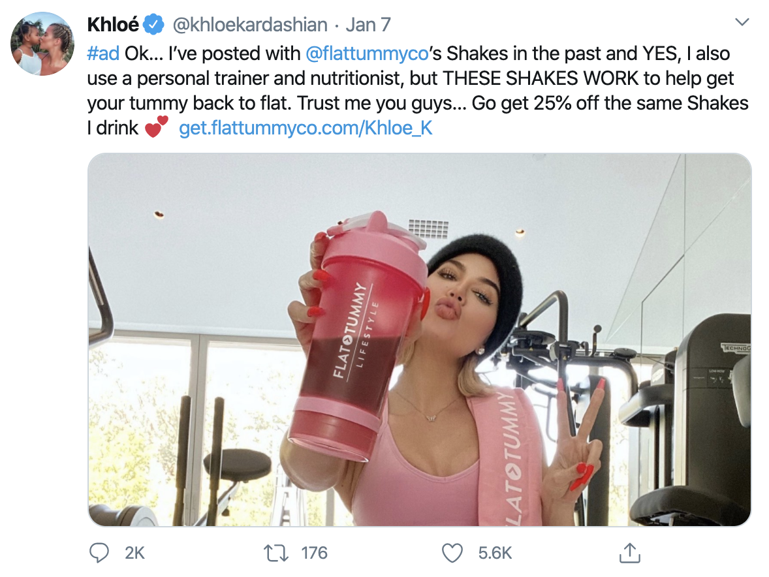
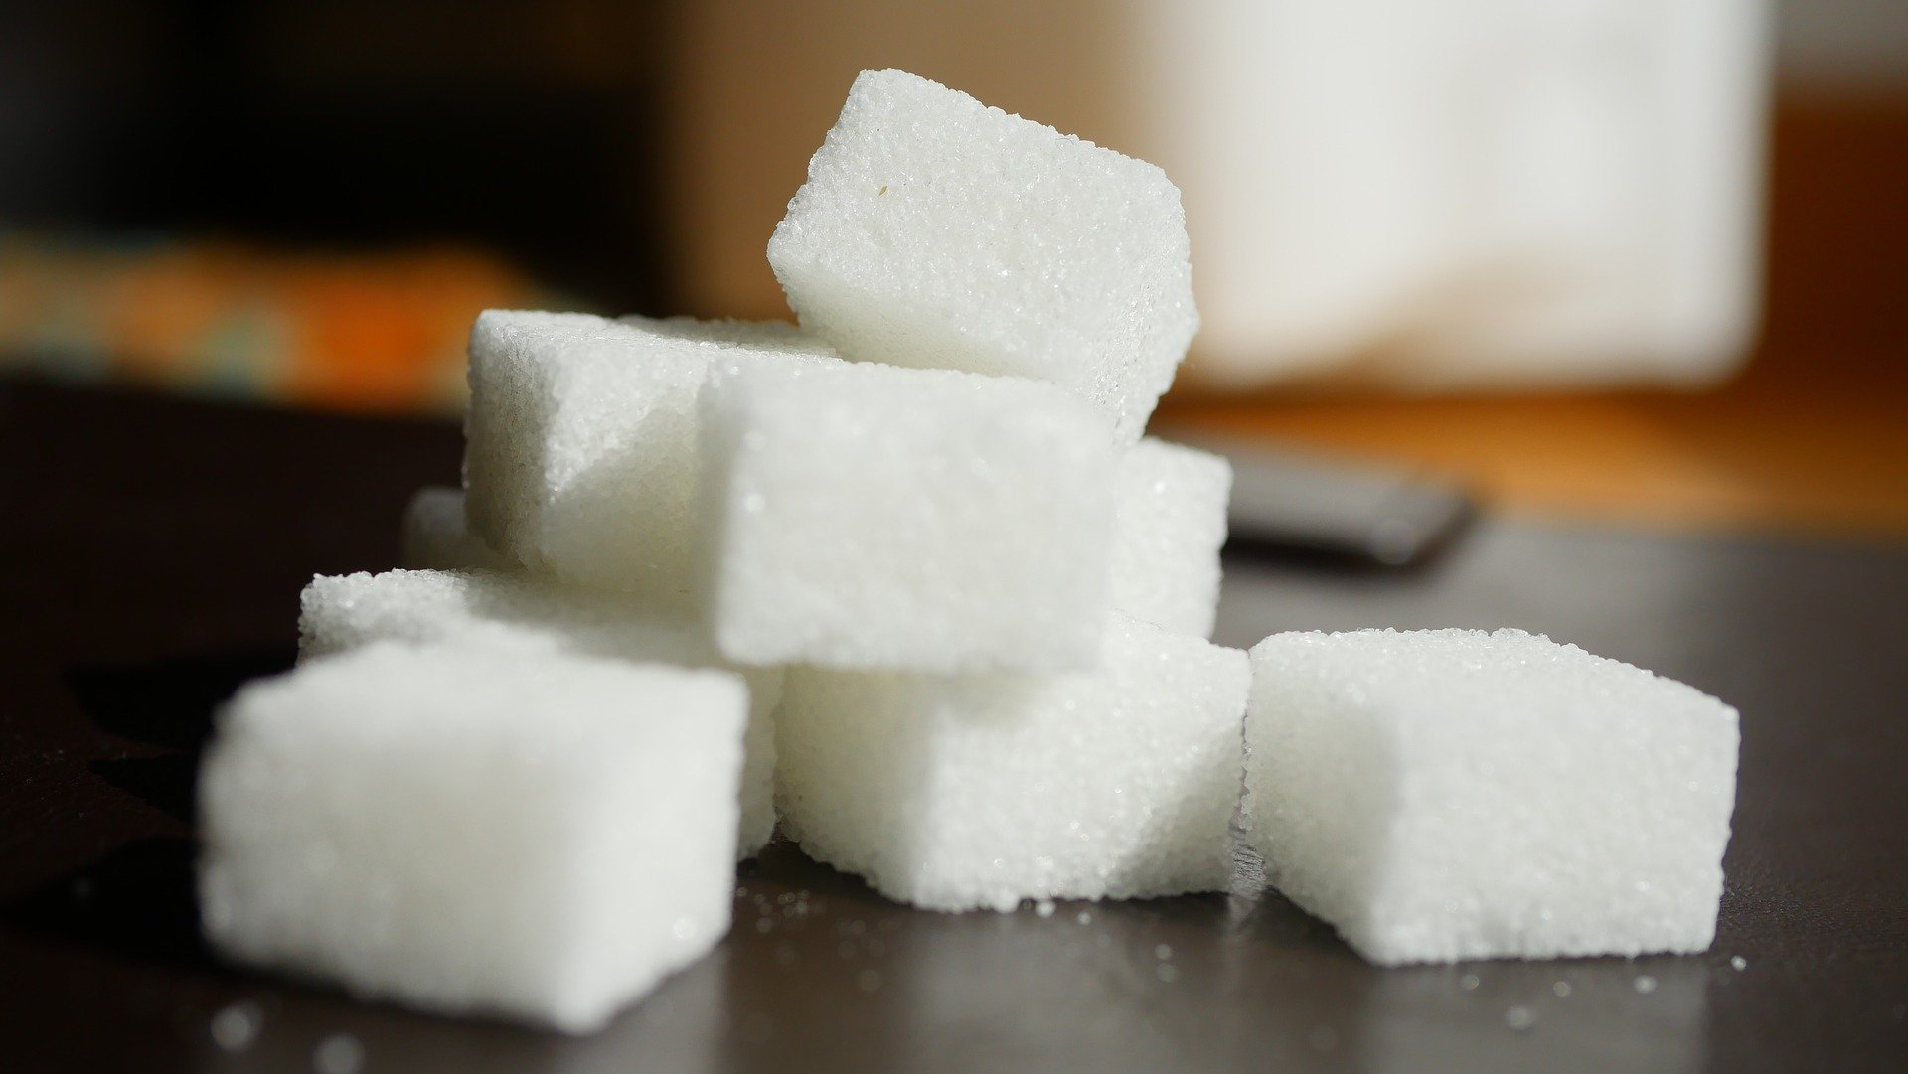
Why might we be sceptical of these claims?
If you took out all the empty space in our atoms, the human race could fit in the volume of a sugar cube.
Notes:
Take a few suggestions, perhaps -
Claim 1:
It’s impossible to test it - she also has a personal trainer and a nutritionist (plus there are other variables, such as genetic predispositions)
The agenda is financial
It’s a scientifically dubious claim
She is a celebrity, rather than a trained scientist
The way in which she is presenting the information is self-aggrandizing, rather than factual and objective
The communication of the information is unsupported (at least in this post)
Claim 2:
This is completely counter-intuitive (see last lesson!)
Weighing this up rationally, it seems extremely unlikely
It seems hard to measure (but is it…?)

Slide 6
Managing scepticism
Should we reject every claim that we are sceptical about?
NO - sometimes they are valid (ie claim 2). But sometimes they are not worth investing our time in (ie claim 1).
So, how do we know when to reject claims we doubt, and spend time investigating claims we doubt?
Notes:
Claim 2 is quite a well-known scientific fact; see this website for an explanation (“atoms are 99.99999 percent empty space. An atom consists of a tiny, dense nucleus surrounded by a cloud of electrons, spread over a proportionately vast area. This is because as well as being particles, electrons act like waves. Electrons can only exist where the crests and troughs of these waves add up correctly. And instead of existing in one point, each electron’s location is spread over a range of probabilities – an orbital. They thus occupy a huge amount of space.”)

Slide 7
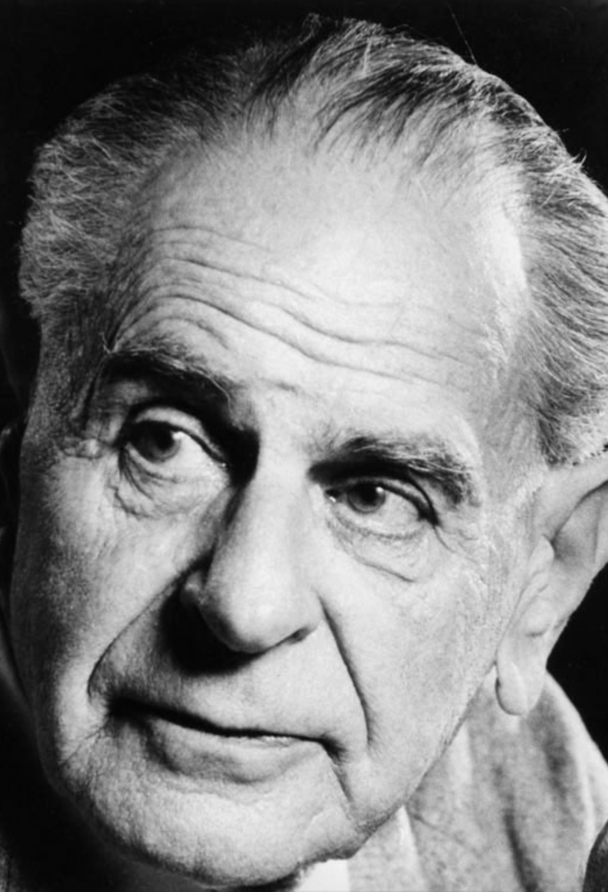
One possible approach: Karl Popper’s idea of ‘falsification’
Karl Popper argued that for the test for whether a knowledge claim or prediction is ‘scientific’ should not be whether it can be proved to be absolutely true - because we can never be absolutely certain about anything.
Instead, he argued that the test for whether a knowledge claim is scientific is whether it can potentially be falsified - in other words, investigating the claim, and gathering evidence to show that it is be wrong.
Notes:
Karl Popper (1902 – 17 September 1994) was an Austrian-British thinker, and one of the most influential philosophers of science in the C20th.
Worth looking at his life and legacy as an extra research task for students. In particular, how do his ideas link to deductivism and induction?

Slide 8
What did Popper mean?
Flat-Tummy shakes make your stomach flat (as long as you have a personal trainer and nutritionist)
If you took out all the empty space in our atoms, the human race could fit in the volume of a sugar cube.
To understand what Popper meant, don’t think about whether these statements are ‘true’ or not, think about whether they can be (potentially) falsified. This would involve investigating them, gathering evidence, and demonstrating that they are incorrect. If you can’t investigate them, or gather evidence about them, you can’t (potentially) falsify them, so they are ‘pseudoscientific’.
In the case of these two claims:
The first claim CANNOT be investigated, and evidence CANNOT be gathered about this, because there are other factors at work, and these may (are probably are) the reason for the acquisition of a flat stomach (plus there are many other variables - such as genes, etc.)
The second claim CAN be investigated, and evidence CAN be gathered about it: we can calculate the amount of ‘space’ in an atom, and work out the total resulting volume of all the atoms that make up the human race.

Slide 9
Which claims can be falsified, and which cannot? How?
Identify which of these statements can be potentially falsified via investigation and evidence-gathering, and which cannot. Explain your answers. Remember - it’s NOT about whether they are true or not, it’s about whether they can be potentially falsified.
Each letter has a numeric value that provides a related cosmic vibration
Water boils at 100 degrees under normal conditions
Fine needles can stimulate acupuncture points and balance the flow of qi
Measuring ambient electromagnetic fields (using, for example, an EMF meter) can indicate paranormal activity
Force equals mass times acceleration
An invisible and undetectable Flying Spaghetti Monster created the universe "after drinking heavily"
Notes:
No. The term ‘cosmic vibration’ has no meaning, and cannot be tested or evaluated, and judged to be false or not.
Yes, just heat the water, and use a thermometer to test when it reaches boiling point.
No, the flow of qi cannot be detected or measured, so this cannot be tested and falsified.
No, there is no evidence that ‘paranormal activity’ exists, so although we can measure electromagnetic fields, we can’t falsify this claim.
Yes, we can carry out experiments to measure and test this, so it can be falsified.
No. Obviously if it is invisible and undetectable, it cannot be tested - and cannot be falsified.

Slide 10
Links to the TOK exhibition
Related exhibition prompt On what grounds might we doubt a claim? (IAP-4)
Refer to the ideas from this lesson to answer this question.
For example, think about reasons we might have for questioning a claim about the world - and whether these reasons are valid or not.
Which objects could help to illustrate your answer?
Notes:
Optional slide, if you want to help students to take ownership of the IA prompts (IAPs) for the TOK exhibition

Slide 11
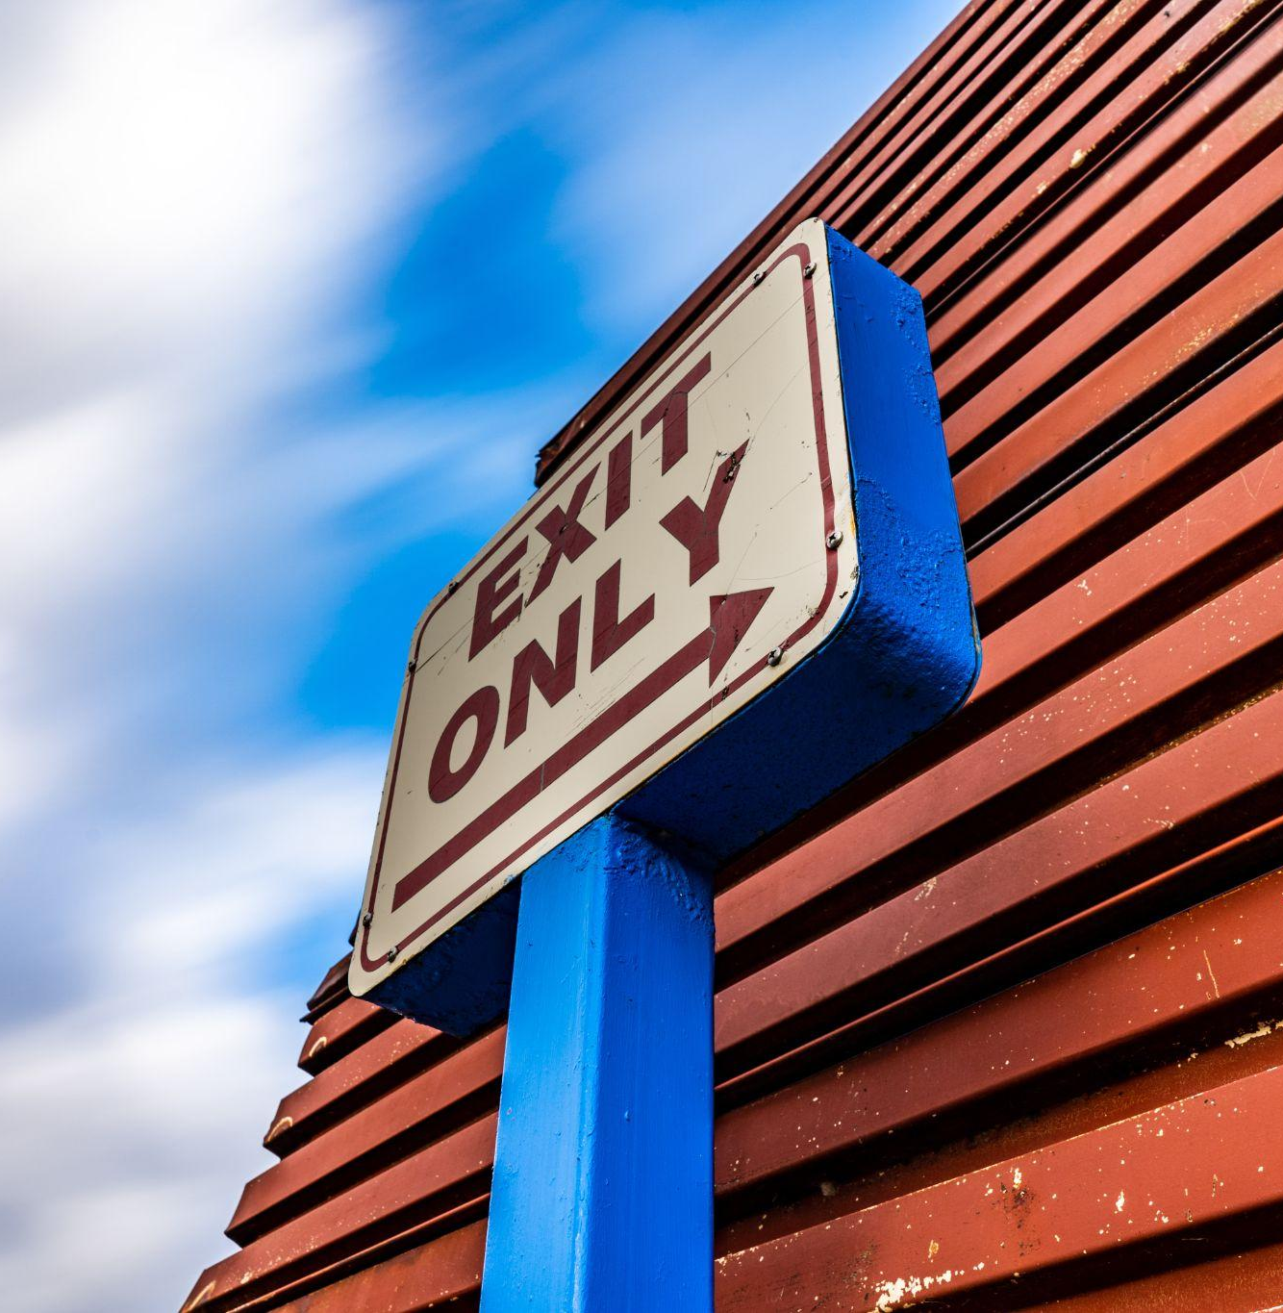
"In the empirical sciences… proofs do not occur, if we mean by 'proof' an argument which establishes once and for ever the truth of a theory.”
(Karl Popper)
What does this indicate about the need to manage (rather than deny) doubt and uncertainty in science?
Notes:
This leads onto 6.8 - Embracing Doubt
See the BQ6 assessment tracker for suggestions on providing feedback, and recording students’ progress.

Slide 12
Linking this lesson to the course
During this lesson, we consider the highlighted aspects of the TOK course
The images used in the presentation slides can also give students ideas about selecting exhibition objects; see also our link below to specific IA prompts
CORE THEME | OPTIONAL THEMES | AREAS OF KNOWLEDGE | TOK ASSESSMENT
Knowledge & the knower | Indigenous societies | The arts | The TOK essay
 | Language | History
 | Politics | The human sciences | The TOK exhibition Could be linked to IAP-4 (doubt), IAP-9 (interpretation), IAP-31 (adequate)
 | Religion | Mathematics
 | Technology | The natural sciences

Slide 13
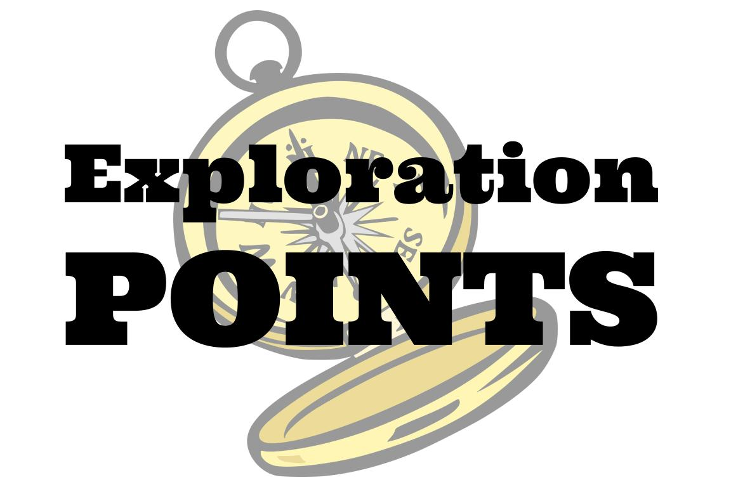
Explore the TOK themes and areas of knowledge in more depth via a range of thinkers, media sources, and other resources, in our EXPLORATION POINTS DOCUMENTS.
Access the documents via the links below. You’ll also find the EP icons on all of the TOK course pages of the site to help you unpack the quotes, KQs, and real-life situations that you find there.
CORE THEME
Knowledge & the knower
OPTIONAL THEMES
Indigenous societies
Language
Politics
Religion
Technology
AREAS OF KNOWLEDGE
The arts
History
Human sciences
Mathematics
Natural sciences
Notes:
Use this slide to access the ‘Exploration Points’ notes for BQ6, which will help students to develop a deeper knowledge of any TOK theme or area of knowledge. This will not only help them to master the TOK course in general, but also craft a great exhibition or essay.
Be ready to provide more guidance on how to use this resource - ie, which media sources to focus on, which questions to address, which TED talks to watch, and which key terms and ideas to understand.

